Slide 1
Introduction to Mendeley
Notes:
Welcome to this introductory session on Mendeley. This presentation will cover the basics of what Mendeley is, how it can help to improve your research and writing processes and how you actually use it.
Mendeley is designed to help you to achieve three main goals:
Organizing your references, by allowing you to create a personal library of materials and structuring it as you see fit. It can help you keep track of different papers you’re reading - by adding notes and highlights, and by remembering where you had reached.
Collaborating with others. Mendeley allows you to come together with other users to share references and to exchange ideas. You can also use private groups to share full-text papers and to collaboratively annotate. You can use this functionality to work with people you see every day, or use Mendeley’s social features to find people with similar interests from around the world.
Discover. In addition to helping you discover new people to work with, Mendeley can also help you to find new research being published in your field - and to recommend new reading based on the contents of your personal library.

Slide 2
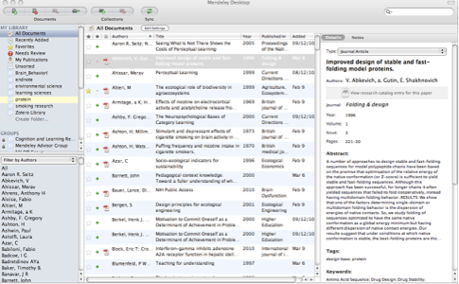
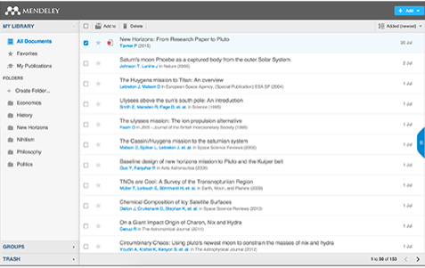
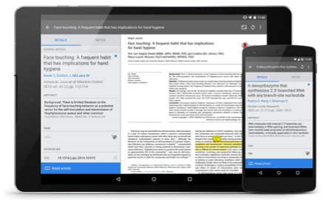
What is Mendeley?
Free Academic Software
Cross-Platform (Win/Mac/Linux/Mobile)
All Major Browsers
Desktop
Web
Mobile
Notes:
Mendeley is free software which is available across a number of different platforms. You can run Mendeley on your computer or laptop, your phone or tablet, and also access it from any modern browser. You can either download the appropriate app for your particular device, or use your web browser to log onto the web version.
Mendeley’s Desktop application offers the most complete experience - allowing you to organize, collaborate and discover, as well as use the citation plugin to cite as you write in Microsoft Word or LibreOffice.
The other versions - Web and Mobile - offer you the ability to access your references on the go, as well as making notes and annotations.

Slide 3
How does Mendeley Help?
Notes:
Mendeley acts as a repository for your reference information. You add papers to your library by importing PDF files stored on your computer, or by retrieving them from other locations - like online catalogs such as ScienceDirect, Scopus, Pubmed or PLOS. You can also create entries for items that you don’t have access to as PDFs by manually entering details.
Materials you add to your library are then stored in the cloud, for you to retrieve wherever you need them. It might be that you want to read a paper on the way home on the train, or you need to write a paper on your main computer. Mendeley allows you to retrieve the same resources with the same enhancements and annotations wherever you need them.

Slide 4
Overview
Using Mendeley
Notes:
Let’s talk briefly about how it works, what it looks like and how you might like to use it.

Slide 5
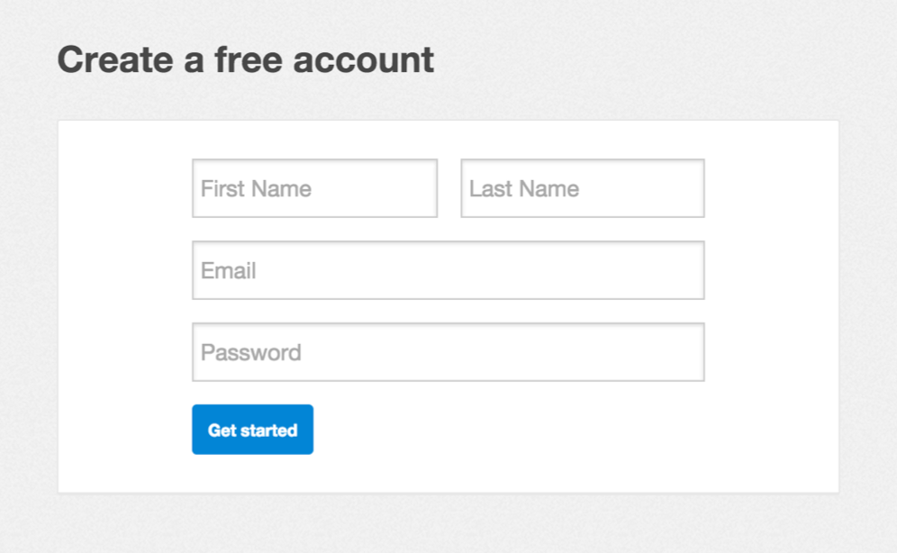
Getting started
Notes:
The first thing you’ll need to do is to create an account via mendeley.com. This is completely free to do and only takes a few seconds. You’ll need a Mendeley account to log into the different versions of the software.
Once you’ve created your account you’ll be prompted to download the appropriate version of Mendeley Desktop for your current machine. You don’t have to do this right away, but it’s a good idea to have the desktop application installed on your main working computer.

Slide 6
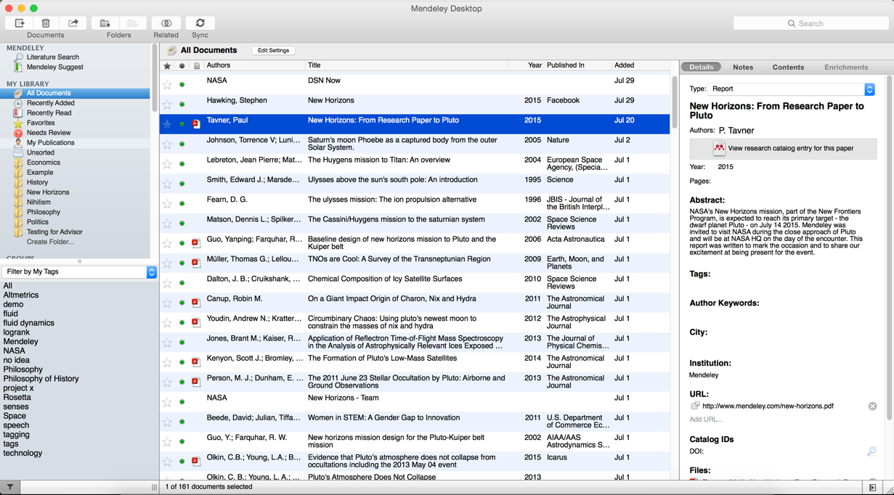
Mendeley Desktop
Notes:
This is how Mendeley Desktop looks. Mendeley Desktop offers the complete Mendeley experience. It allows you to build, maintain and order your personal library. It also allows you to access reading and writing functions.
When you first open Mendeley Desktop, you’ll need to log into your Mendeley account. This ensures that any changes you make are being made to your own account and will be carried across when you log into different devices.
Mendeley Desktop follows a three column structure. The left-hand panel allows you to navigate through different filtering options for your library. When you click on different folders or groups listed in this column, different lists of papers will be returned in the main panel. In this screenshot we have ‘All Documents’ selected, which means the main panel is listing all of our references.
The middle panel allows you to select individual references. Clicking on a reference listed here will display this document’s details in the right-hand panel. You can also select multiple papers to undertake bulk actions, such as mass deletions or additions to folders.
The right panel shows the details of your selected reference. You can also use this panel to modify the details by clicking into the individual fields. You should carefully check and correct the details displayed in this panel as ensuring accuracy here will ensure that your citations are totally correct.
We’ll go into the details of how the interface works in just a few minutes.

Slide 7
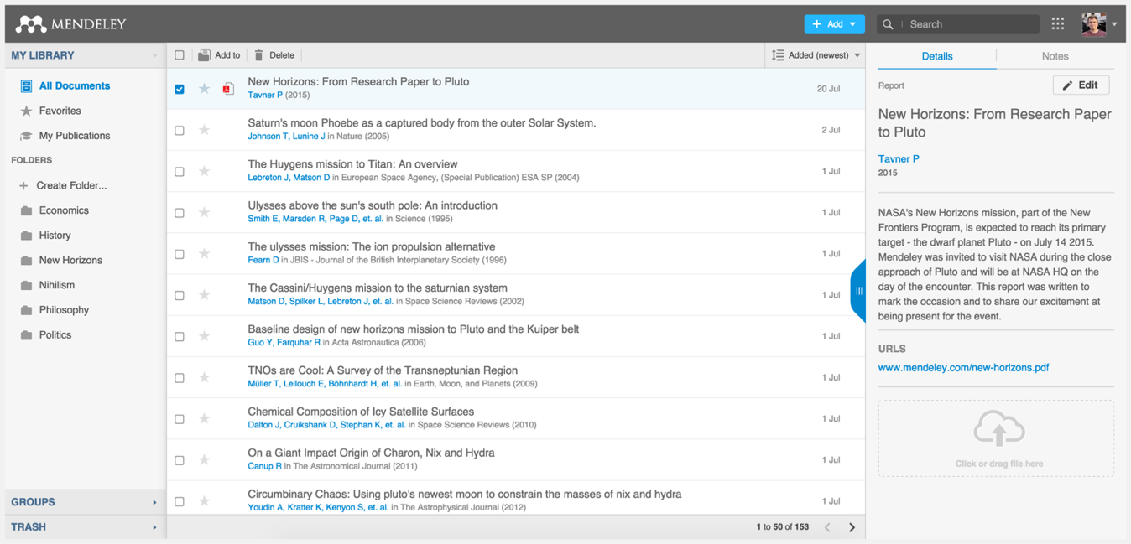
Mendeley Web
Notes:
Mendeley Web is the version of Mendeley accessible via your web browser. You’ll need to be logged into your Mendeley account in order to access it.

Slide 8
Organize
Setting Up A Library
Notes:
So let’s talk about how Mendeley can help you to bring organization to your references.

Slide 9
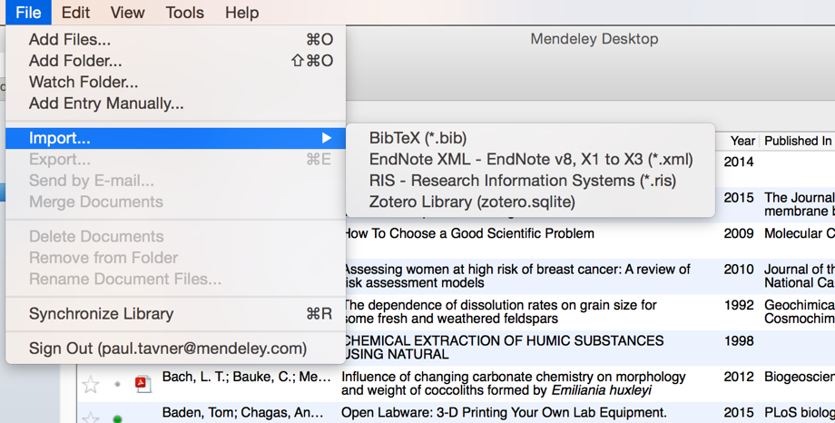
Adding Documents
Select a file or folder to
add from your computer
Import from another reference
manager, or BibTeX
Watch a folder
Add reference by
manually entering details
Notes:
Mendeley also offers a number of other options for adding material to your library. You can find these by opening the File menu.
You can choose to add individual files, or the contents of an entire folder by browsing to the relevant location on your computer.
You can opt to ‘watch’ a folder - which will mean that Mendeley monitors that location for any new items being dropped into the folder. If it finds a new document, that document will be automatically added to your Mendeley library.
You can also easily import a library from other reference managers, so if you’ve tried out EndNote, Reworks or another solution and found them not to your liking, you can carry across your library to Mendeley easily.
You also have the option to create a reference manually - which will allow you to complete a number of fields by hand.

Slide 10
Sync
Notes:
Syncing is a core concept in Mendeley. Whenever you make changes in Mendeley, you’ll need to sync in order to push those changes up into cloud storage. Syncing will also pull down any changes made on other devices. It’s a good idea to sync regularly to ensure that your documents and annotations are saved in the cloud.

Slide 11
Organize
Managing Your Library
Notes:
Now that you’re familiar with adding references to your library, let’s talk about how you can order and structure your library.

Slide 12
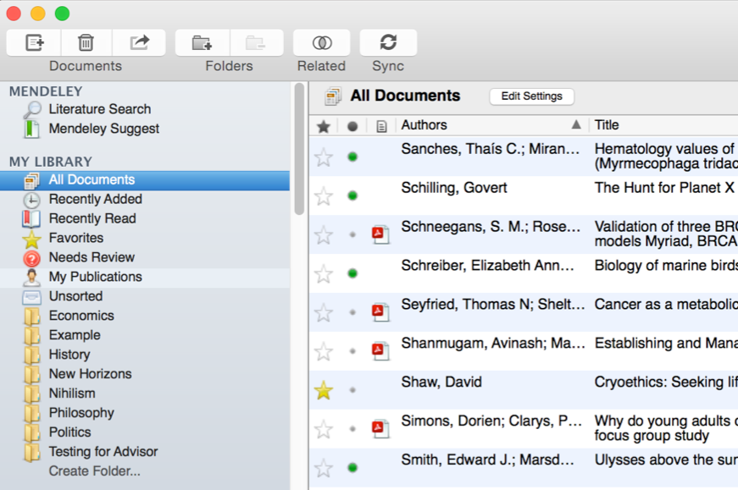
Manage Your Library
Use column
headings
to order your
references
All items in
your personal
library
Items added
in the last two
weeks
Mark entries
read or unread
Access your
recently read
items
Entries with
attached PDFs
can be opened
with the PDF
Reader
All items you’ve
starred in your
library
Items in need
of review
Star items to
mark them as
favorites

Slide 13
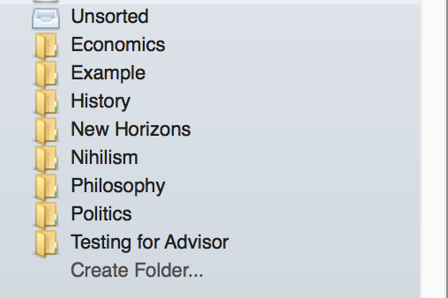
Create and Use Folders
References not added to a folder
will appear in ‘unsorted’
Your folders will be listed below.
Drag and drop to re-order them.
Use ‘Create Folder’ to enter a
new folder name.
Notes:
Folders allow you to quickly file your references under different topic headings. You can drag and drop references from your library onto the folder name in the left panel to add that reference to a folder. You can also create folders within existing folders.

Slide 14
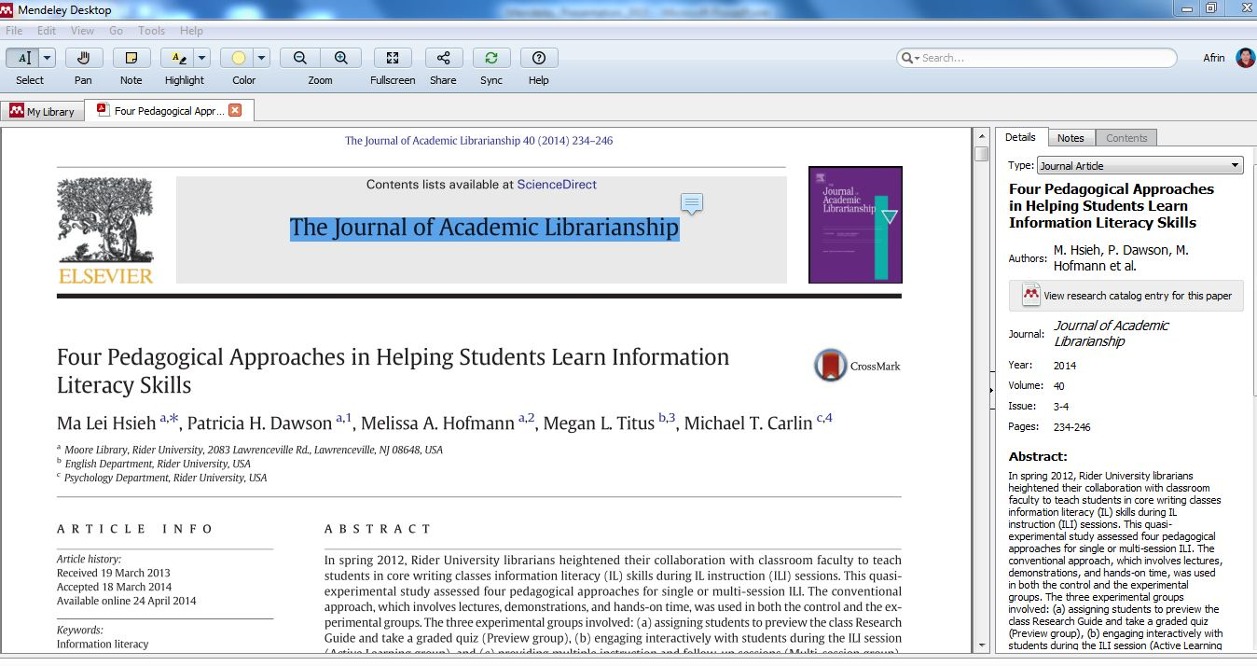
The PDF Viewer

Slide 15
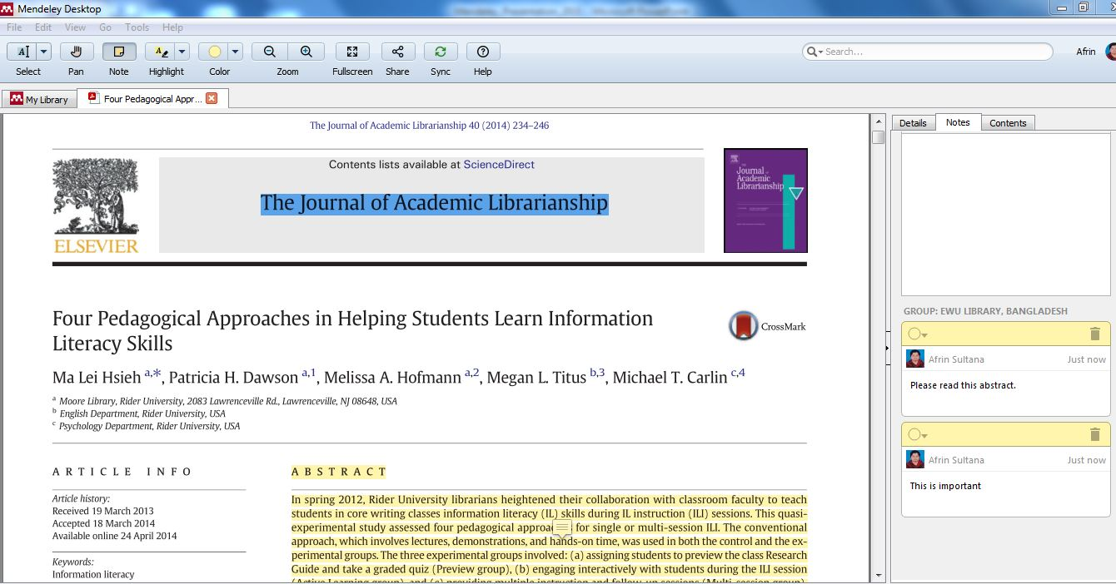
Highlighting and Annotating
Notes:
You can highlight important passages using the Highlight tool - just as you would when reading a physical copy. This allows you to pick out important passages from a paper.
You can also add notes to the paper to help organize your thoughts. These can be done either in the Notes box which appears in the document detail panels. These notes are document-wide and can also be viewed from the main library view - without opening the paper for reading.
Alternatively, you can add ‘sticky notes’ to specific locations in the text. These allow you to make content-specific notes at a particular location. Sticky notes that are added in this way will appear in the list of annotations in the document details panel. You can use these entries to jump to the appropriate location within the paper - allowing you to retrieve your notes in context.

Slide 16
Cite
Using the Mendeley Citation Plug-In
Notes:
One of the most popular features of Mendeley is its ability to improve the citing process. Mendeley makes it a lot easier to insert properly formatted citations throughout a paper you’re writing - and will automatically generate a bibliography for you. It also allows you to restyle your manuscript’s citations with just a few clicks - making it ideal for resubmissions to different journals or publishers.

Slide 17
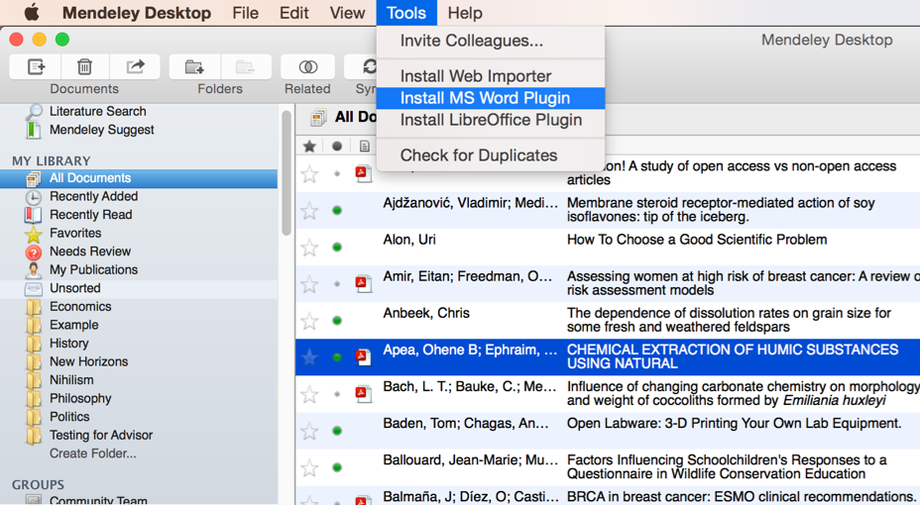
Install the Citation Plug-in
Notes:
You’ll first need to install the citation plugin. This can be done via the Tools menu within Mendeley Desktop.
The citation plugin supports Microsoft Word and the free alternative LibreOffice. Depending on which of these you have installed, you will see the prompt to install the plugin.
Once installed, the citation plugin will appear within your word processor. Its appearance will vary slightly depending on your operating system, but you will see the same buttons and options in both.

Slide 18
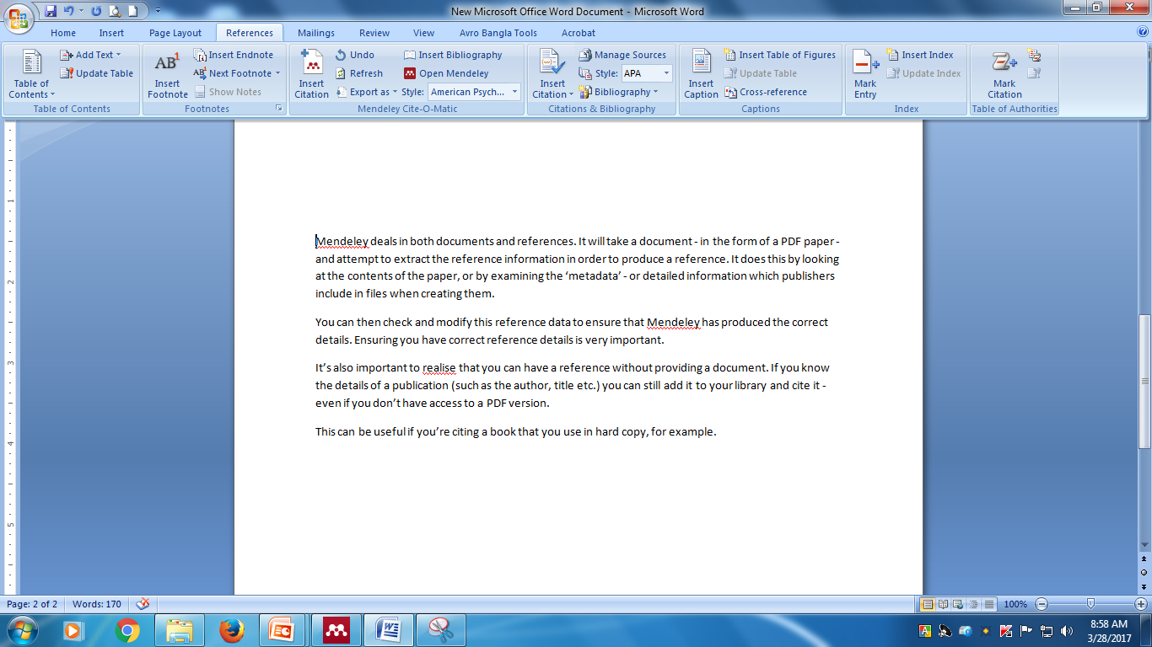
Generate In-Text Citations in Word

Slide 19
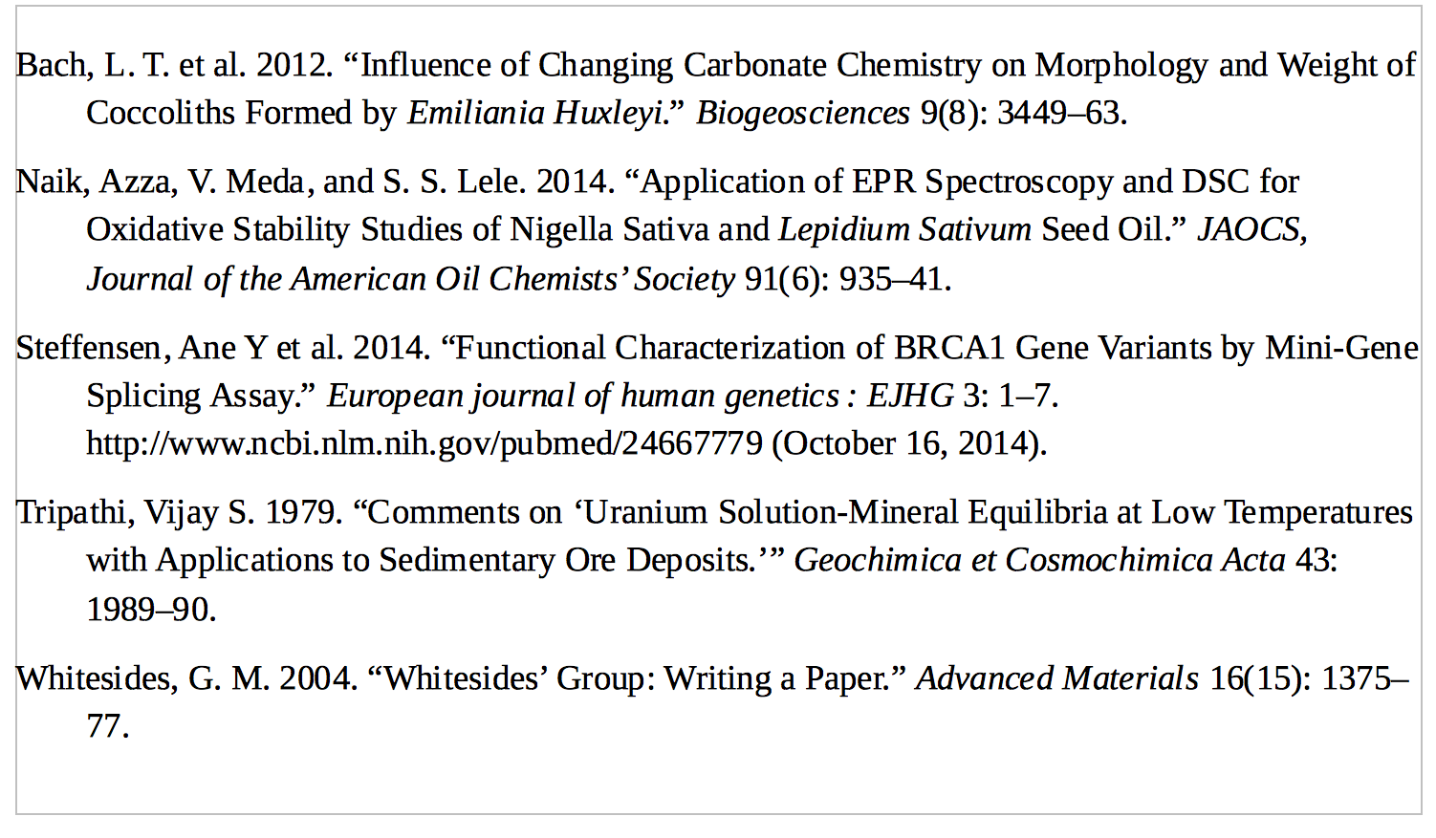
Inserting Your Bibliography

Slide 20
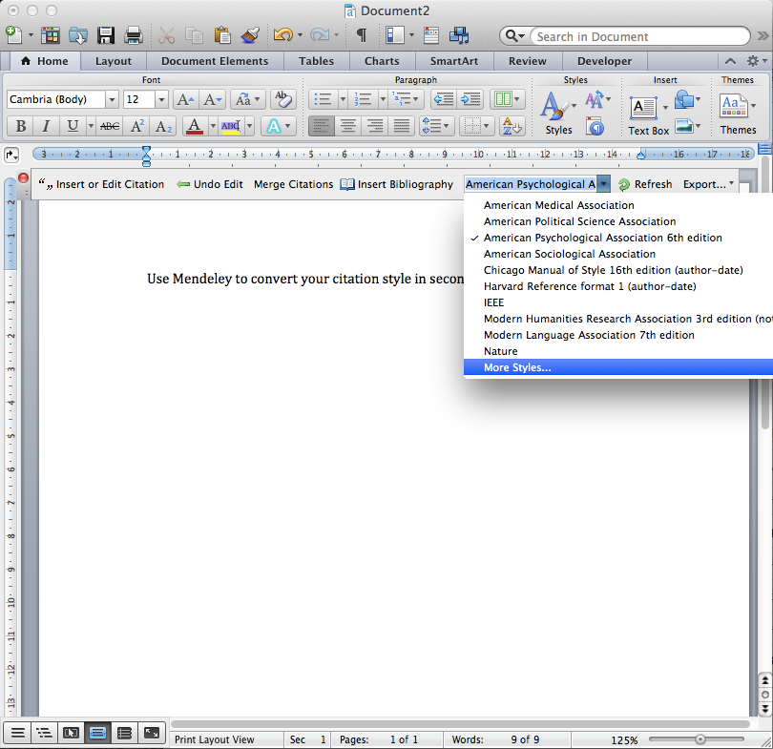
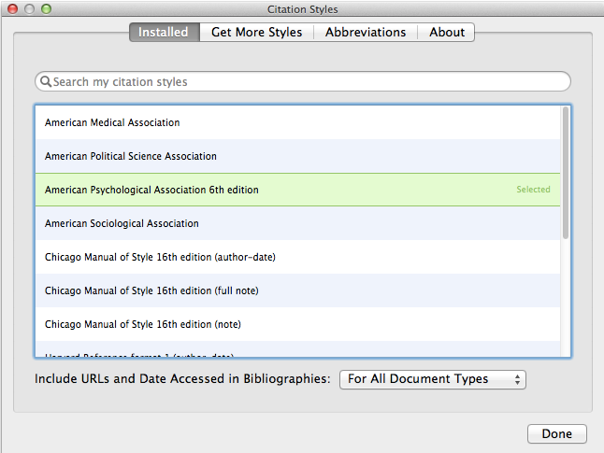
Finding a Citation Style
Notes:
Citation Styles are sets of styling instructions which control how your citations and bibliography appear. Different publishers and institutions require different formatting for citations when you wish to submit a paper.
Using Mendeley, you can choose the appropriate citation style for your manuscript - and also switch between different styles with just a few clicks. Mendeley will restyle all the citations in your manuscript automatically. To change citation styles, open the styles dropdown menu which appears on the Mendeley toolbar. If you don’t see the style you need, you can click ‘More Styles’ to be taken to the Styles tool within Mendeley Desktop. This will also allow you to download and install new styles in seconds.
Mendeley allows you to use over 1,600 different citation styles - but comes pre-installed with some of the most commonly used, such as APA, Harvard and IEEE. If you still can’t find the right style or you’d like to customize an existing style, you may want to try the Mendeley CSL Editor, which allows you to customize citation styles. Saved styles are added to the Mendeley database, and will appear in your drop-down menu in Word.
You can also share created styles with other Mendeley users. The editor can be found at http://csl.mendeley.com

Slide 21
Collaborate
Join and Create Groups to Share References
Notes:
Let’s talk a bit more about sharing now. Quite often you may want to share materials with other Mendeley users - or even to collaborate directly on a particular paper.

Slide 22
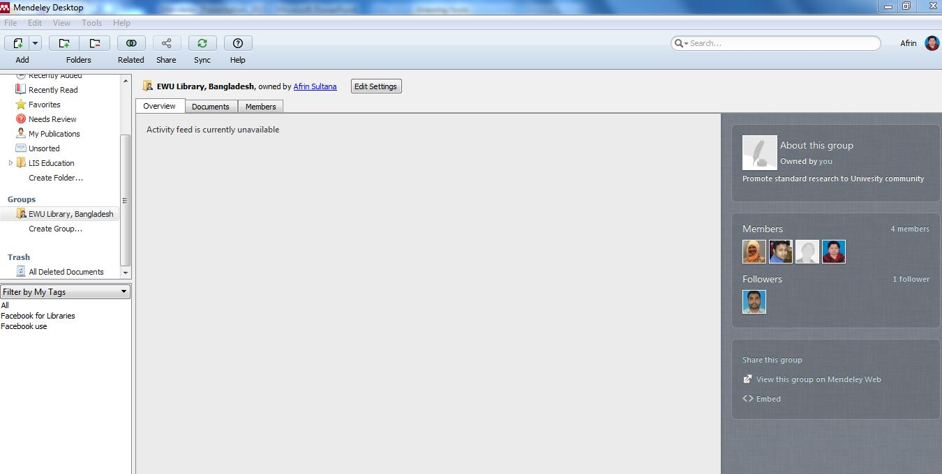
Create Groups
See the groups you created, joined or follow.
Add documents to a group by dragging and dropping.
Notes:
Groups are Mendeley’s solution to the the problem of collaboration. They allow you to come together with other users and to share resources.

Slide 23
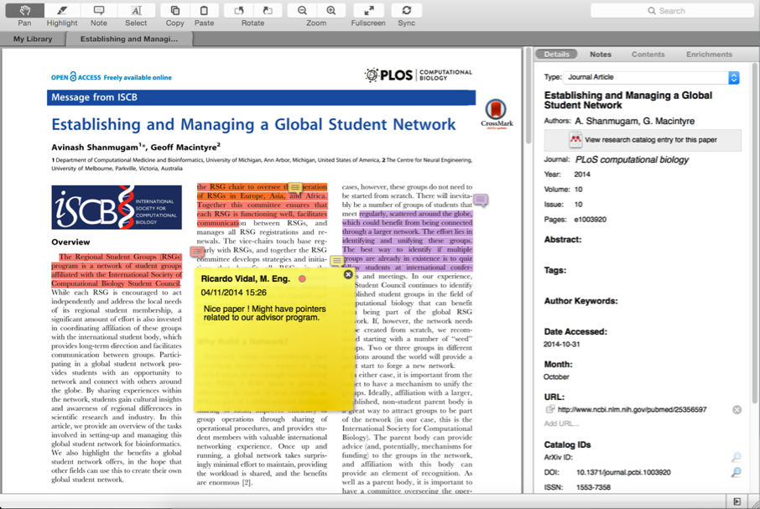
Private Groups Collaborate with Your Research Team
Share full-text
documents with members of your private group
Share highlights and annotations
Notes:
Private groups, like all groups, offer the ability to communicate with other members via messages posted to the newsfeed. You’ll also receive notifications when new resources are added.
Each post on the group’s newsfeed creates a discussion thread - allowing you to comment on other members’ posts.
You can open papers shared with the private group using the Mendeley PDF Reader. Any highlights and annotations you add to the group version will be visible to other members of the group. Each contributor will be assigned a color to help distinguish their changes.
Add notes or highlight particular passages to draw your collaborators’ attention to particular sections of the paper.

Slide 24
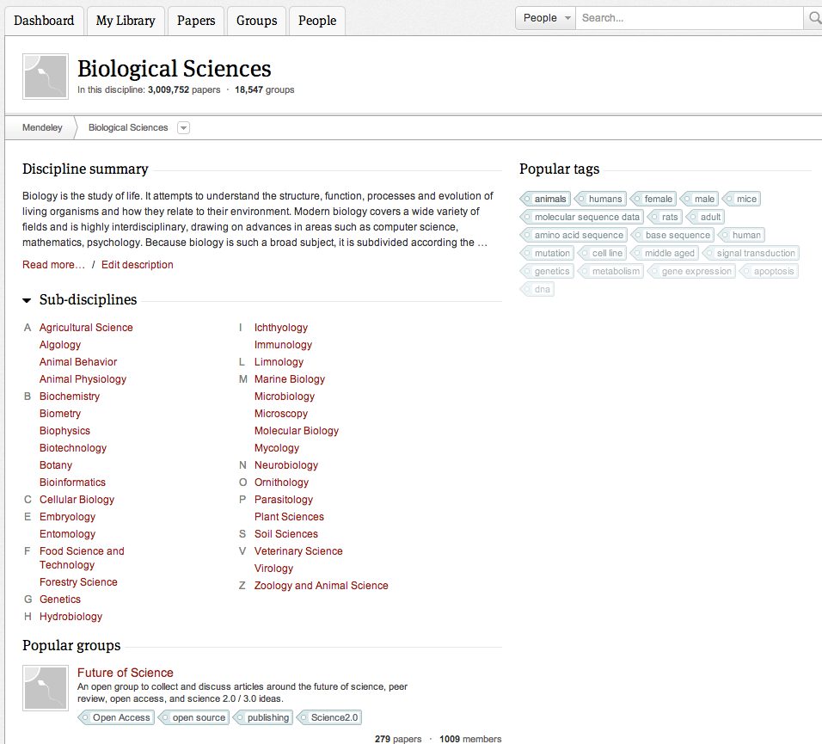
Browse & Join Public Groups
Browse by discipline to discover new groups
Notes:
You can also browse popular public groups by subject to locate popular groups associated with each topic.
Joining public groups is also a good way to connect with other Mendeley users who are active in your field. This can lead to collaboration and sharing of resources.

Slide 25
Create your research profile
Receive personal stats on how your work is used
Promote your work and interests to a global audience
Connect with colleagues
and join new communities
Share your work with other researchers
Notes:
Completing your Mendeley profile is a great way to promote yourself and to encourage other users to get in touch. You can use your profile to share your interests and publications with the world.
When viewing another user’s profile you will have the option to ‘follow’ them, which will keep you up to date with their activity. You can also send them a direct message.

Slide 26
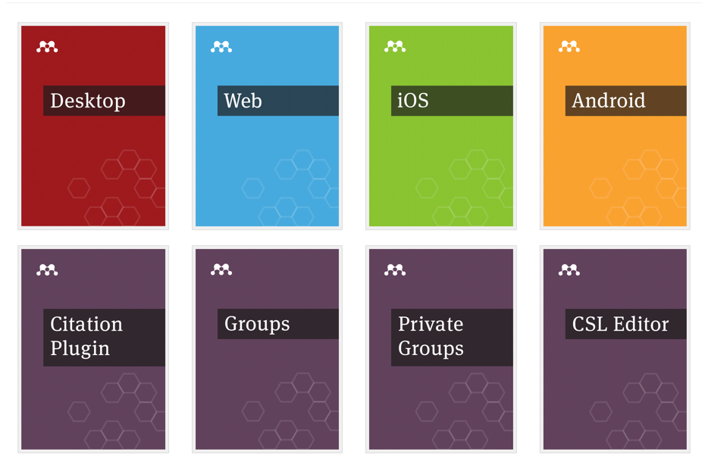
Resources
http://community.mendeley.com/guides
Notes:
Mendeley’s Resource Center has detailed guides to each of the different versions, as well as feature guides that cover specific components. It’s a good idea to use these guides to familiarize yourself with the different aspects of Mendeley. There are also a number of video guides available.

Slide 27
Thanks
Notes:
Hopefully we’ve covered enough of the basics of Mendeley in order for you to get up and running.
Thanks for your time today and we hope enjoy using Mendeley!

